Slide 1
AFE process improvement
Problem: AFE Ownership Issues. Nobody wants to own the tracking of AFE spending and provide visibility and closure of AFE.
Need you to do a quick high level process mapping on our AFE (investment application till closure).
Starting from Business was awarded and Planning Team (project manager) raised AFE for approval. Financial approval cycle involving various departments.
Upon Approval, Who is entrusted with raising the PRs for the purchases, it’s approval cycle and who monitor the AFE approved amount and actual spendings.
Who track the spendings and finally who close the AFE. At each of the stage, We need visibility.
Objective: Recommend which department, IE, project manager, operation program manager, finance (have to take into account Corp finance division of authority and responsibility) Log management Admin should be the owner in each step of the process and take into consideration Purchasing System limitation too.

Slide 2
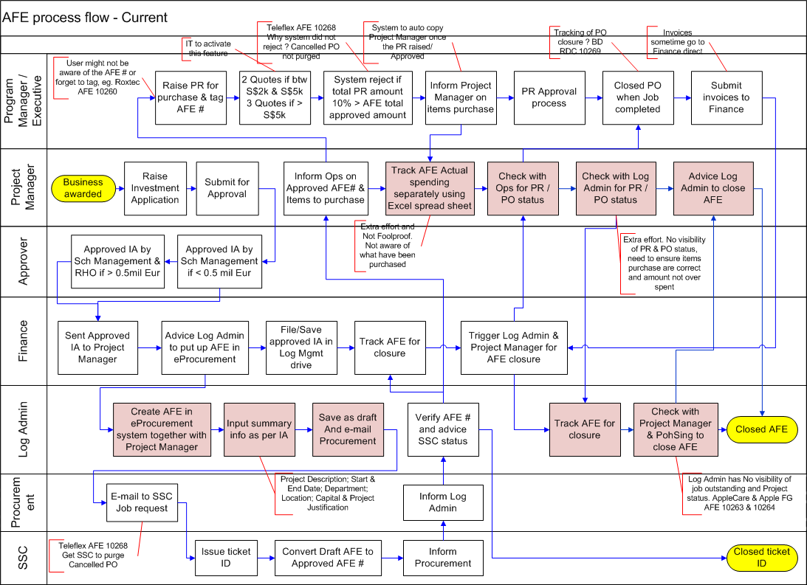
Non-Value Added step

Slide 3
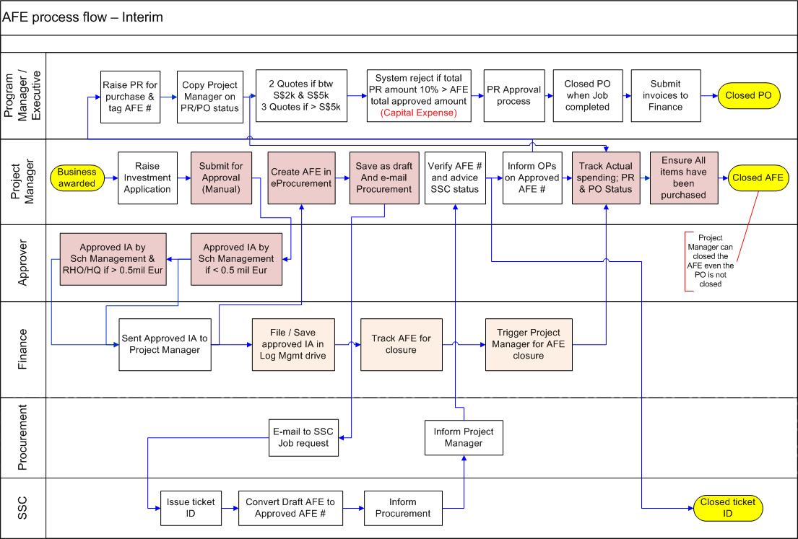

Slide 4
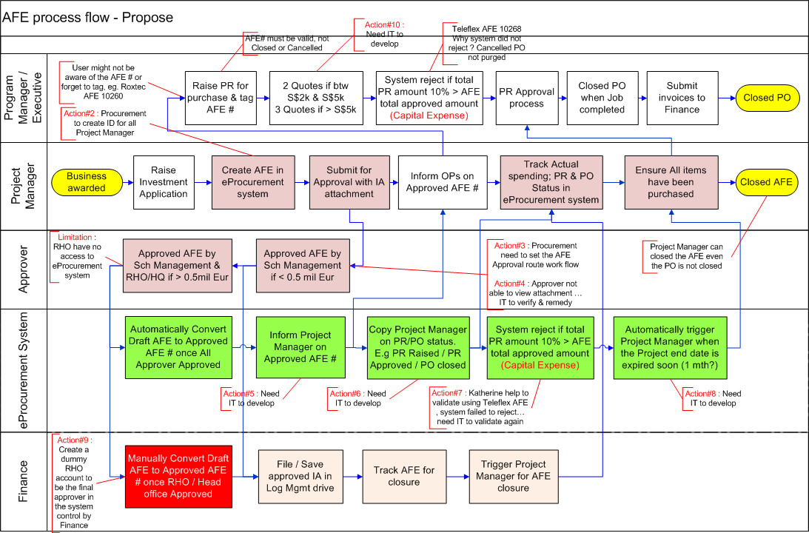

Slide 5
To-Do-List
 | Problem | Actions | Who | When | Status
1 | Validation of AFE Approval route and other features | UAT in test environment | Procurement/Finance/Log
2 | No access to eProcurement system | Create ID for Project Manager/AFE Requestor and allow to create & view AFE only | Procurement & IT
3 | Additional job Request to SSC | Setup AFE Approval routing work flow in eProcurement system Phase1 - Logistics Management Phase 2- All | Procurement & IT
4 | AFE Approver not able to view attachment | IT to verify & remedy | IT
5 | AFE Requester are not copy on approved AFE | System copy AFE Requester once AFE approved | IT
6 | AFE Requestor have no visibility on PR & PO status | System copy AFE Requester/Project Manager on PR & PO status | IT
7 | System not rejecting PR when AFE amount used > 110% AFE Approved amount | Activate system to check UAT to verify | IT / Log | 31Aug11
8 | AFE not closed/ not aware of open AFE | System to trigger AFE requester when the project expired date end soon (1mth) | IT
9 | RHO approver not in eProcurement system | Create dummy RHO approver in system control by Finance | IT
10 | 2 Quotes if btw S$2k & S$5k 3 Quotes if > S$5k | IT to turn on this feature | IT

Slide 6
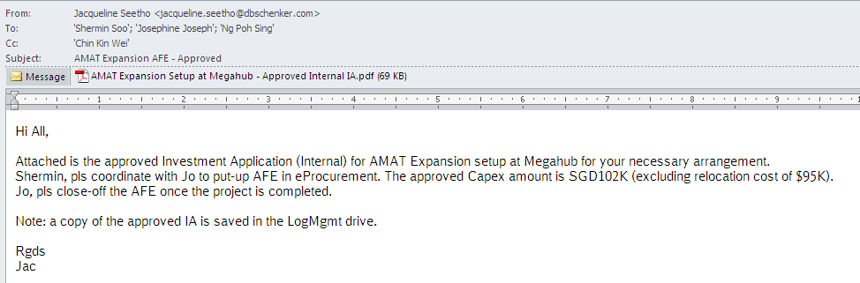

Slide 7
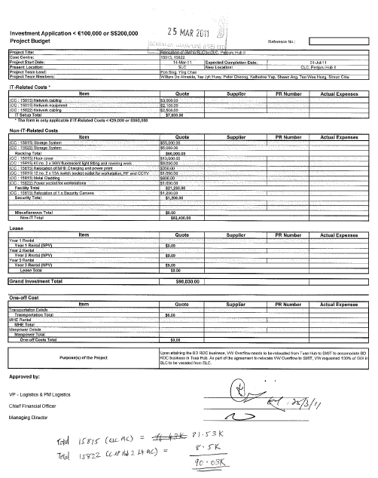

Slide 8
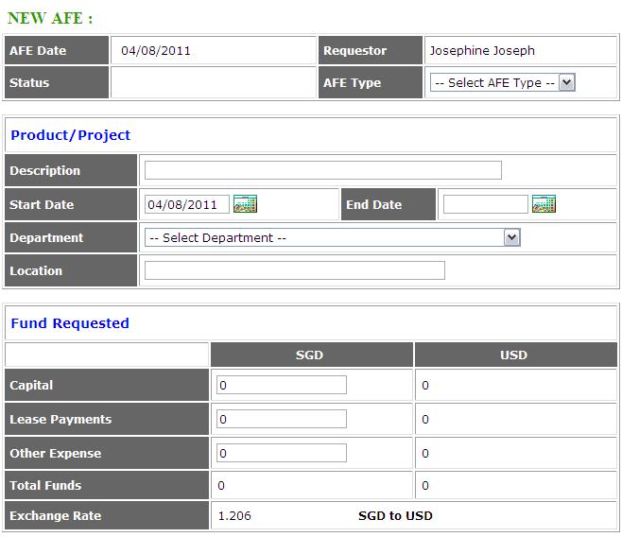

Slide 9
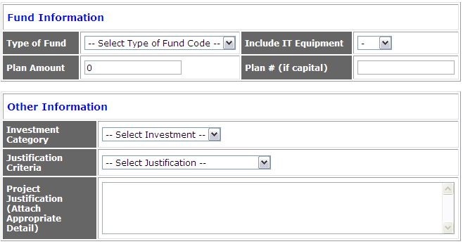
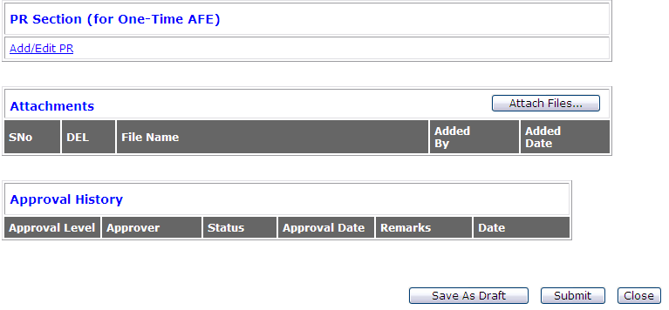

Slide 10
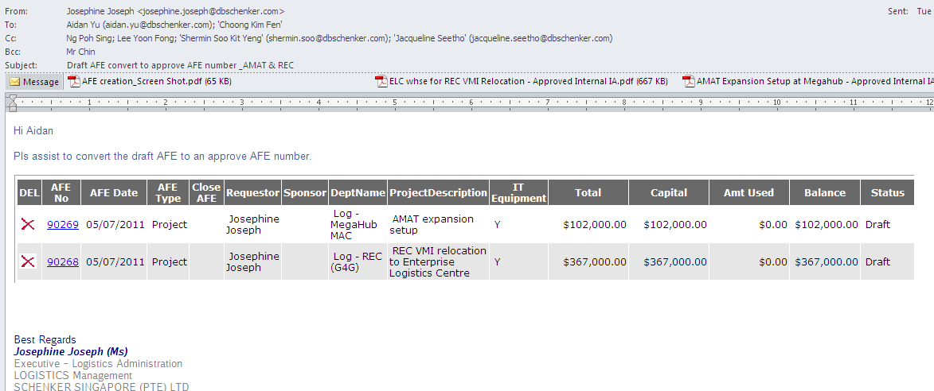
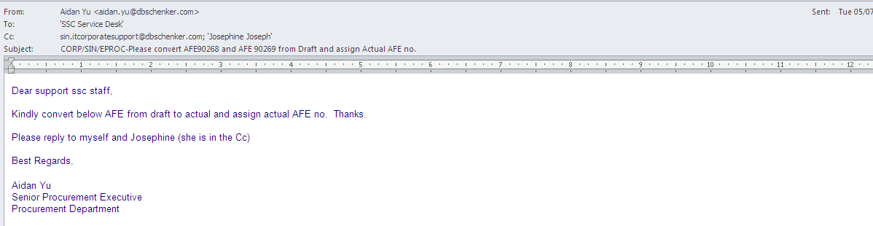

Slide 11
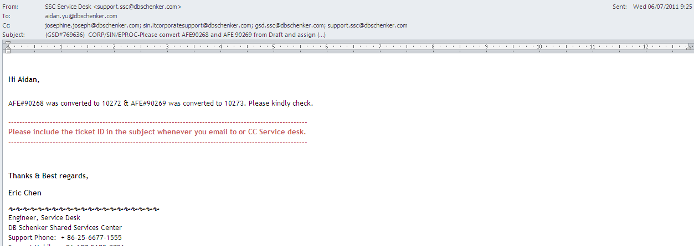
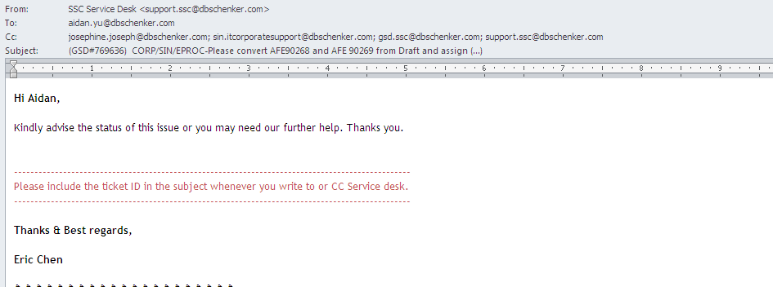

Slide 12
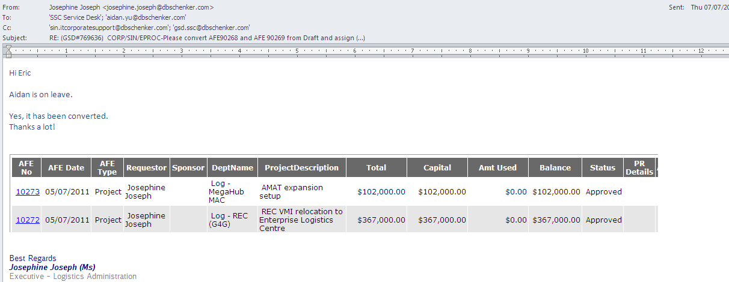
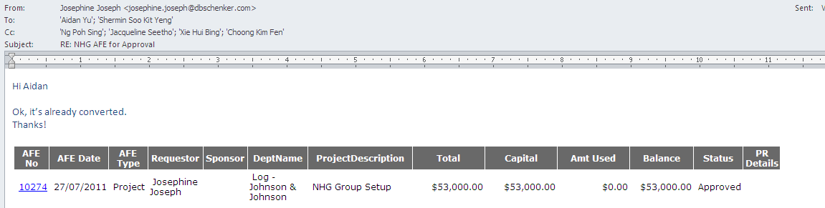

Slide 13
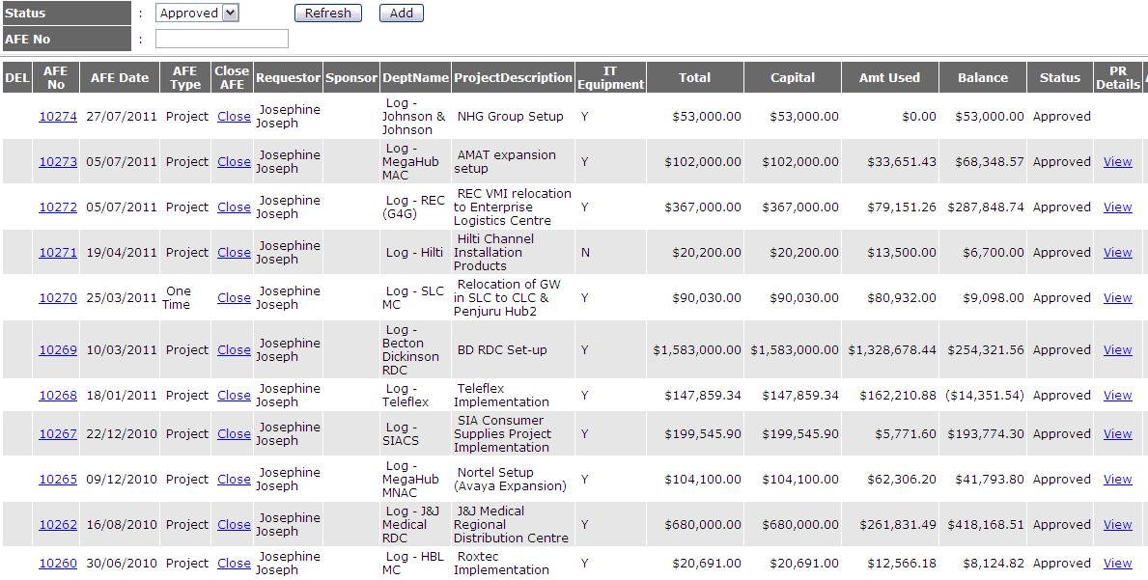

Slide 14
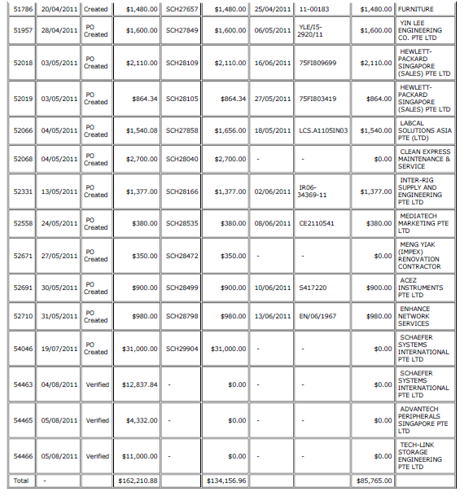

Slide 15
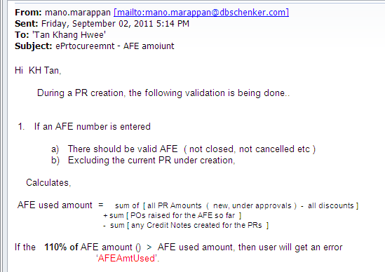
IT to validate again…….. AFE used amount ($166,350.88) exceed the AFE approved amount ($147,859.34) by 9%
Why PR#54544 still can raise?

Slide 16
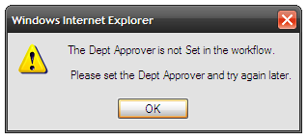

Slide 17
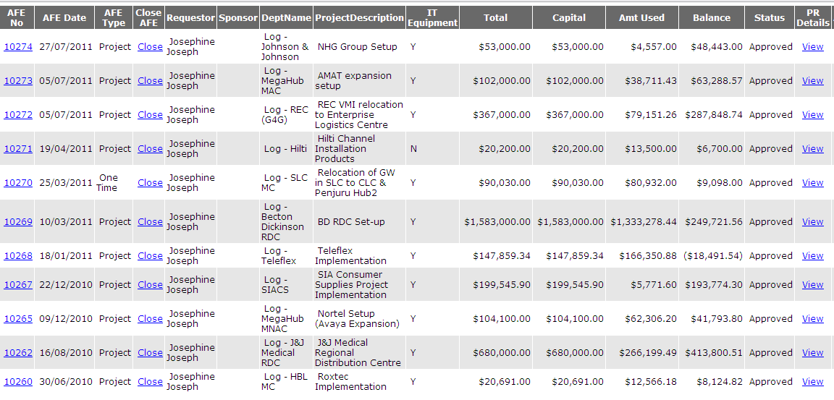
AFE - Approved
Pending closures

Slide 18
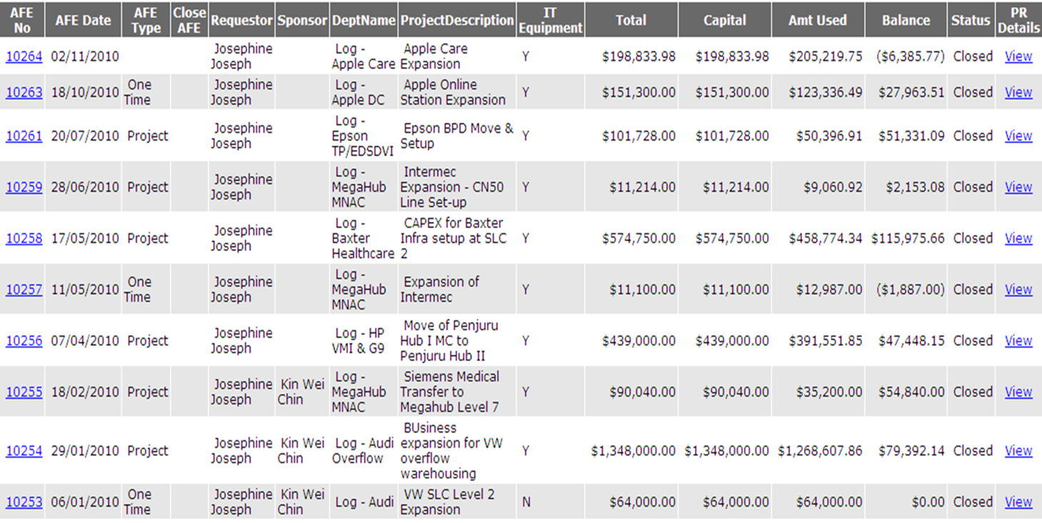
AFE – Closed
2010

Slide 19
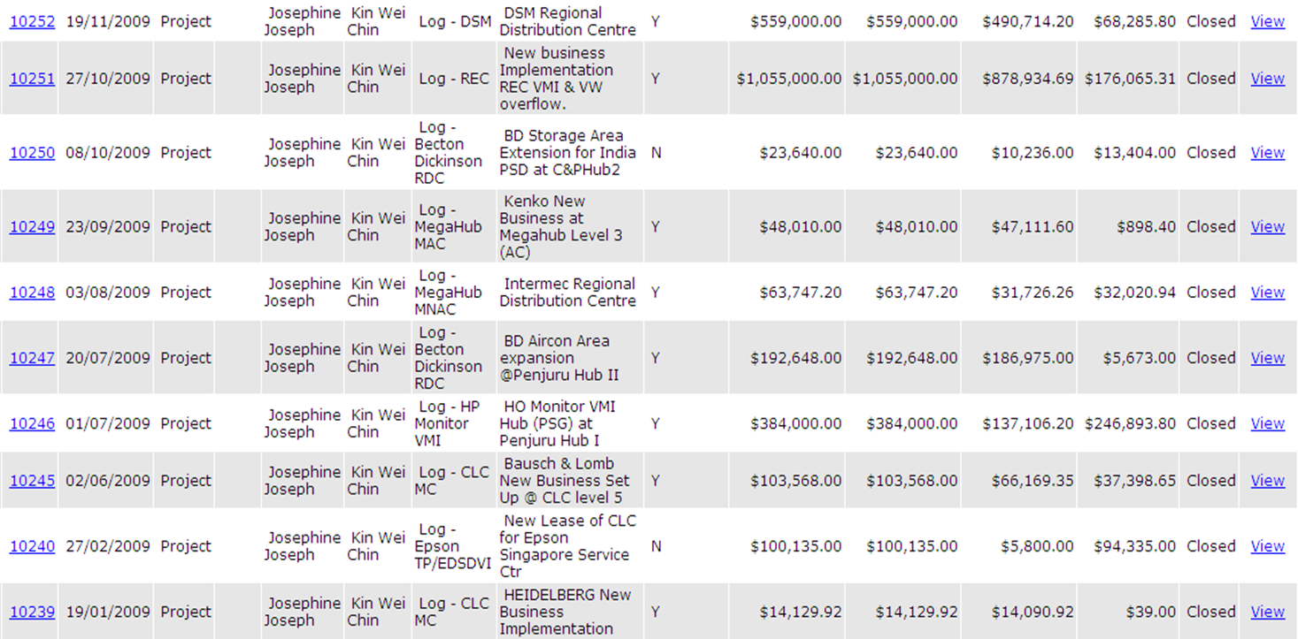
AFE – Closed
2009

